Slide 1
For the Real Estate Professional

Slide 2
URFresh Overview ‘We Make Homes Healthier’

Slide 3
The Company (Since 2001)
Vision
To provide the Home Maintenance, Building Service Contracting and eventually the Health Care industry with the most efficient and cost effective biological decontamination process available.
Mission
To improve the quality of life by providing a healthier environment, in an efficient, cost effective, technically sound and environmentally sustainable manner.

Slide 4
The Market
110 million homes in the US¹.
50% have at least one occupant whose health is negatively impacted by indoor air pollution, including mold, VOCs and other allergens².
55 million potential customers for the FreshStart process
17 million Americans with asthma³, with sufferers statistically clustered at 2.2 per household, indicating a potential market of over 8 million homes.
5 million businesses with employees¹
1 US Census Bureau
2US EPA
3 American Academy Allergy Asthma and Immunology

Slide 5
One Problem
Indoor allergens can trigger an asthma attack*
Indoor air quality has 2 to 5 times more impact on your health than outdoor air*
Over 80% of asthma attacks come from dust mite droppings found in the home*
* Henry Fishman, M.D.
Diplomate American Board of Allergy and Immunology, American Board of Internal Medicine and National Board of Examiners. National host of PBS’s “TV MD” and USA Today’s “Health and Medicine” Internet Doctor

Slide 6
Another Problem
Your listing, or the home your client wants to purchase is PERFECT except for the (pick one – or more):
Pet odors
Tobacco smoke odors
Mold
Musty/Mildew odor
Strong new paint and new carpet odors
Pet dander

Slide 7
How Can We Help?
With our patented FreshStart interior decontamination process, we neutralize and eliminate the effects of:
Allergens
Surface mold
Smoke damage, Tobacco smoke, and Pet odors
Bacteria and Viruses
Pet dander
Dust mites
V.O.C.’s and New carpet and paint odors
At the molecular level to provide a healthier home or work environment

Slide 8
What Does That Mean to You?
Potentially:
Faster home sales
More home sales
Less complicated home sales
Healthier home sales
Fewer objections/obstacles
Greater customer satisfaction
More $$$$$

Slide 9
The Science – Hydroxyl Radicals
OH⁻ Production
Naturally in the atmosphere, by the reaction of lightning, oxygen, and water, (nature’s sanitizers) and also
From the decomposition of hydrogen peroxide (H₂O₂) via UV light
Hydroxyl Radicals are “a molecular chainsaw”, deconstructing carbon and sulfur based molecules and turning them into inert carbon and oxygen

Slide 10
The Equipment
UV Light Generators and H²O² humidifiers

Slide 11
Accomplishments
US patent 7,407,624 B2 and 33 embodiments
Field tested 1600+ homes, offices, warehouses, school buildings, vehicles and boats
96% of customers surveyed have or intend to recommend the service
Achieved 40% survey returns (J.D. Power gets 25%)

Slide 12
Providing the Service
4500 Sq. ft. home
New owner
Severe smoke odor,
Paint out-gassing,
Allergy

Slide 13
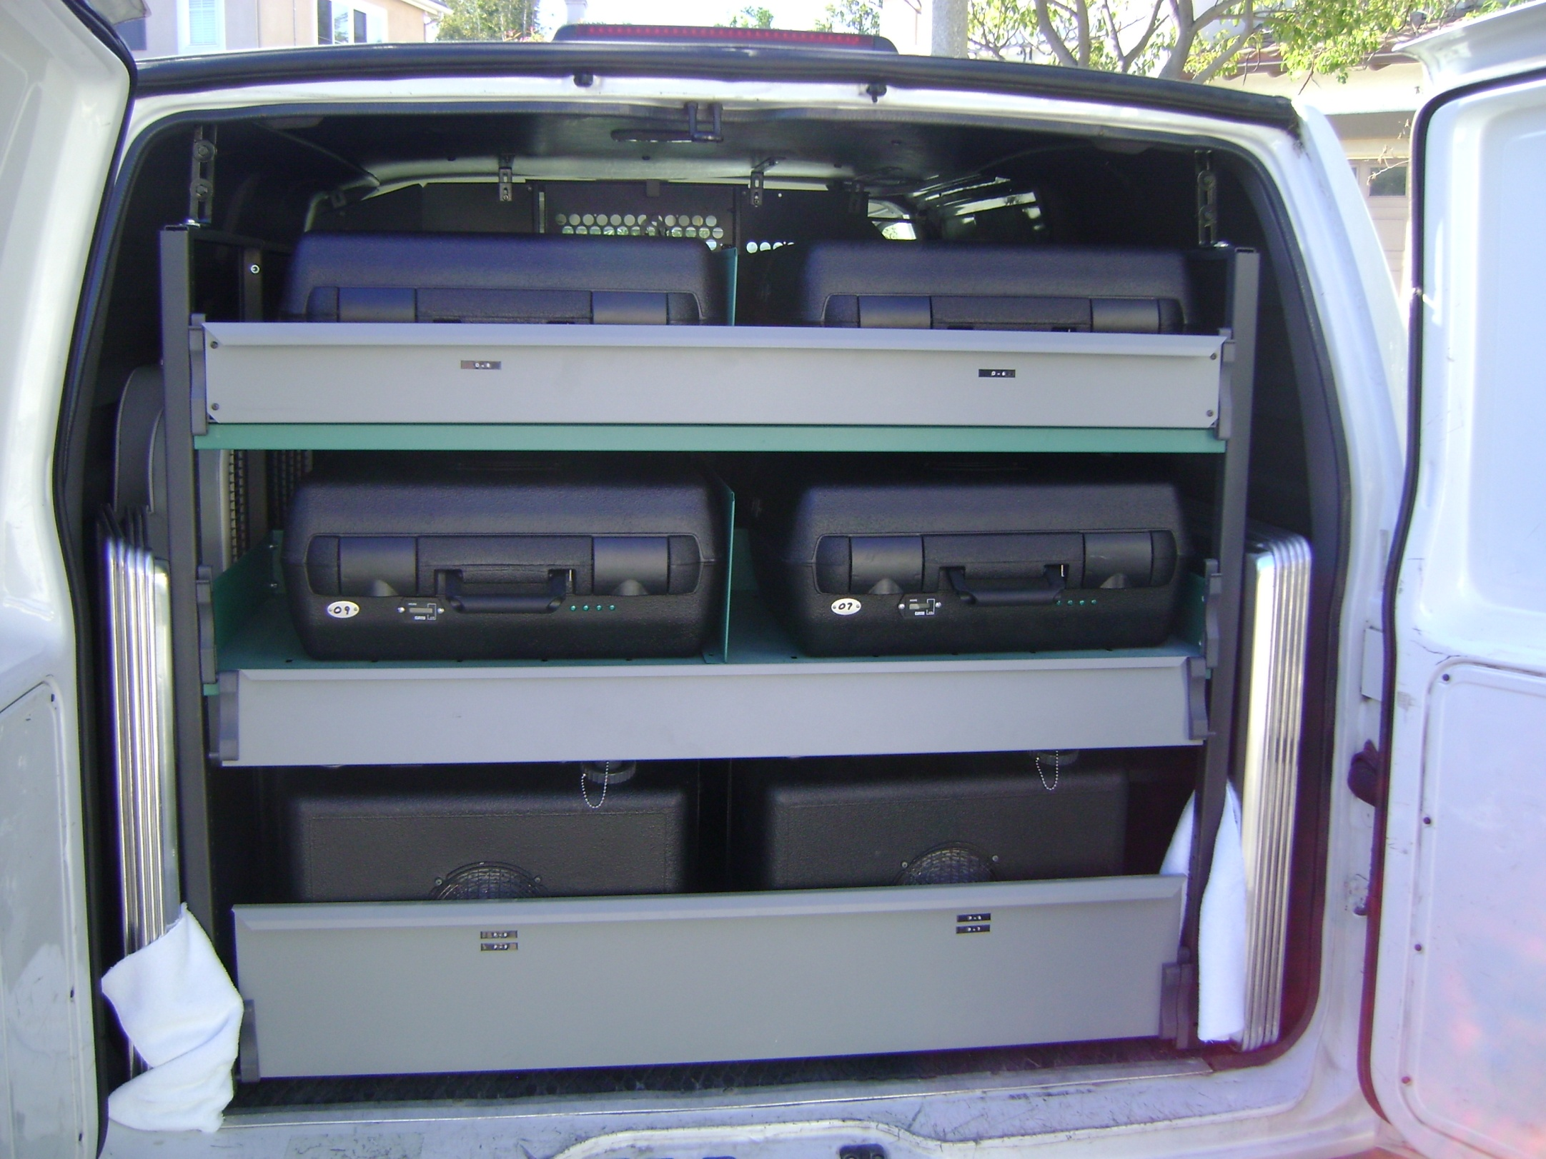

Slide 14
Preparation and Data Collection

Slide 15
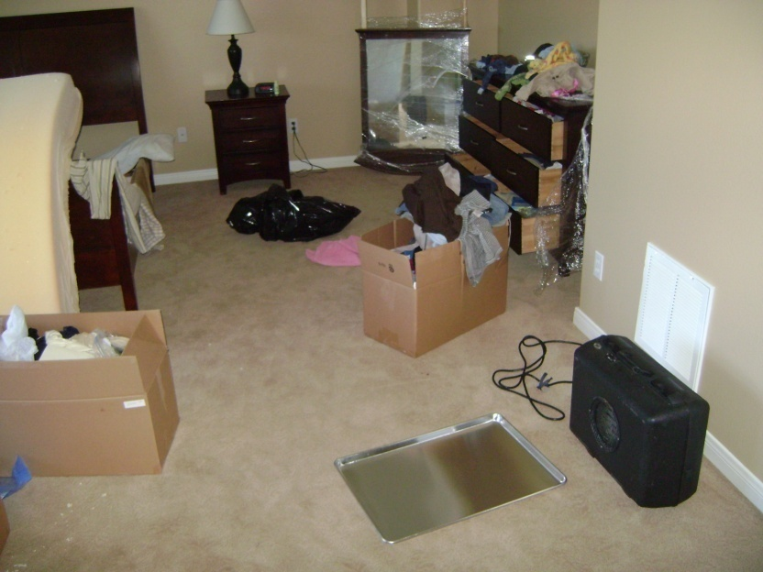
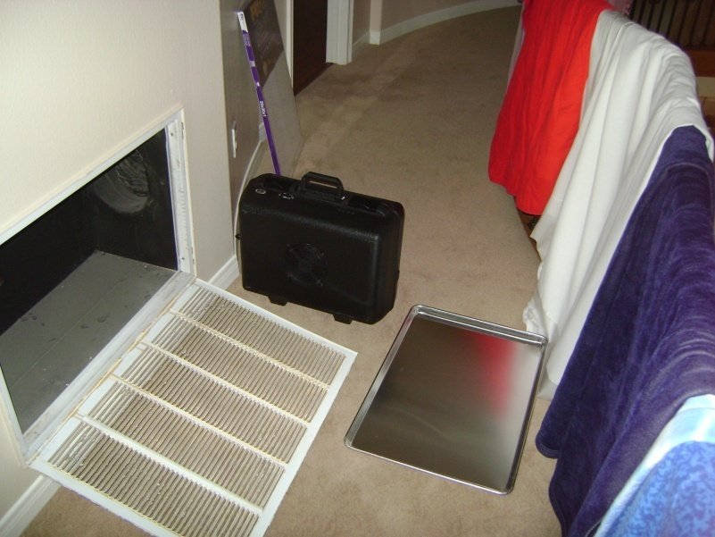
Equipment Placement

Slide 16
Impact
Typically
1 hour set up (usually less)
3 hours treatment
1 hour tear down, removal, and ‘closing up’ the house
Great for fresh fruits and veggies, house plants, aquariums
Home is immediately ready to occupy – smells fresh and clean, BECAUSE IT IS!
Many people remark it reminds them of laundry hung outside

Slide 17
Questions?

Slide 18
Thank You! Contact Information: Iowa 515-777-9208 California 866-873-7374 www.URFresh.com

